Slide 1
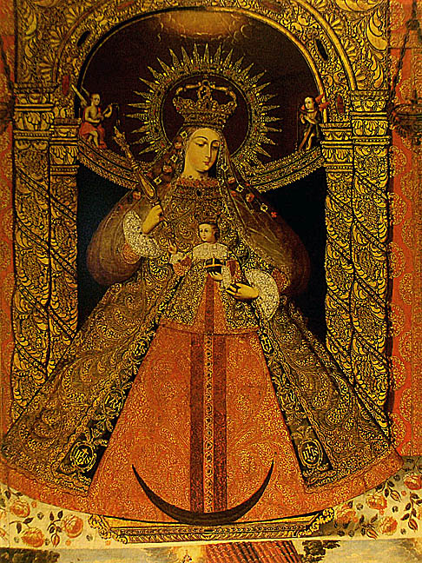
Eyeing the Other
The Indigenous Response
16th-18th Centuries
From Gauvin Bailey, Art of Colonial Latin America, 2005

Slide 2
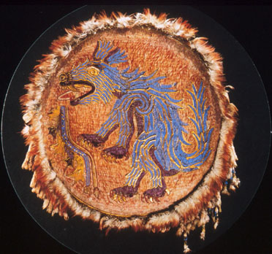
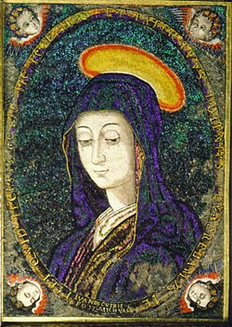
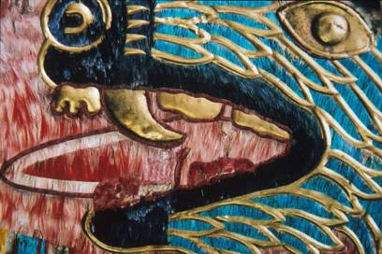
Juan Bautista Cuiris (Spanish, active in Mexico) Feather Picture of the Virgin Mary, Mexico, Michoacán, c. 1550/80, hummingbird and parrot feathers on wood; signed
Aztec feather shield, pre-Conquest, detail
Shows gold work

Slide 3
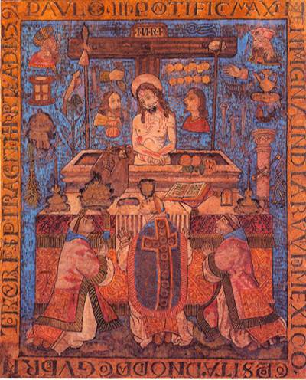
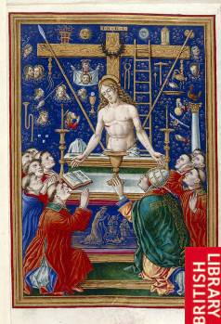
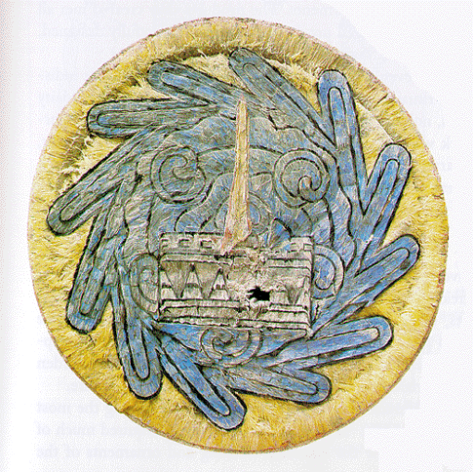
(left) The Miraculous Mass of Saint Gregory, Mexico City, 1539, feather on wood, 26 x 22” Commissioned by the first colonial governor of Tenochtitlan as a gift for Pope Paul III
(center) Giovani Pietro Birago, Mass of Saint Gregory, engraving from the painting, Milan, Italy, c. 1490 , typical source for colonial Mexican feather painting
(corner right) Pre-Conquest Aztec feathered shield, c. 1500 CE

Slide 4
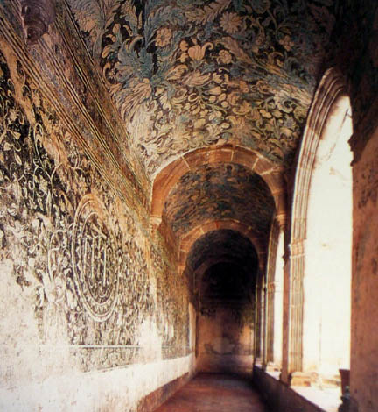
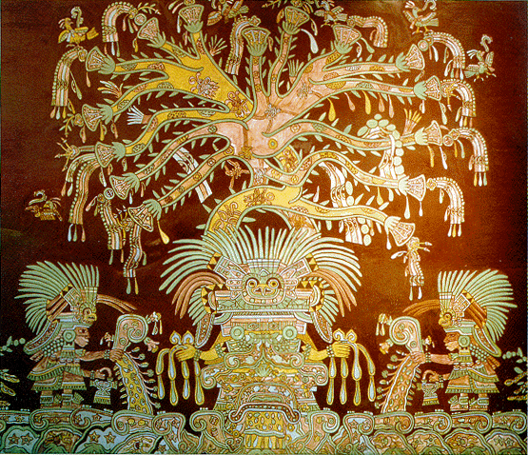
Anonymous Nahua muralists, The Garden of Paradise, mid-16th century, Augustinian mission church of San Salvador, Malinalco, Mexico; compare (right) artistic restoration of Teotihuacan mural detail, “Garden of Paradise” (The Great Goddess) c. 600 AD

Slide 5
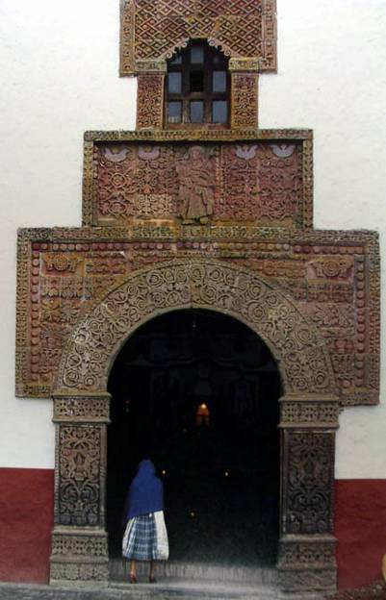
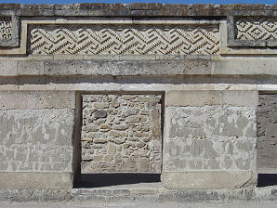
Façade of Santiago (Church of Saint James), Angahuan, Michoacán, Mexico, 16th century. Decorative carving has a probable source in Spanish and Flemish pattern books [planimetricism] but also Zapotec (right) stone mosaic, Mitla, Late Post Classic (750-1521 CE)

Slide 6
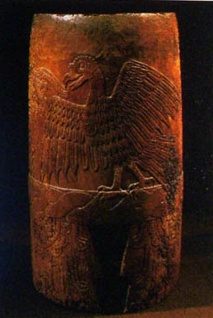
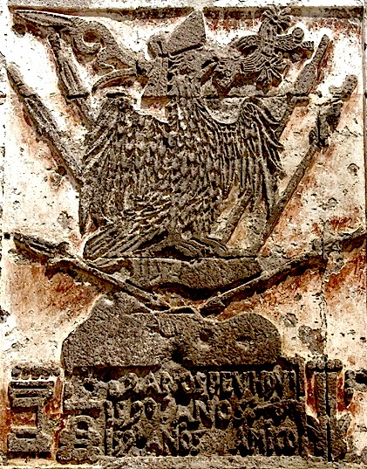
Tequitqui (Aztec colonial hybrid) style (deep carving, rounded edges, flatness; tequitqui subject, Aztec eagle Tequitqui implies a racial connection, and that the artists were full-blooded Nahua, which was not always the case.
Left: Aztec Eagle Warrior, foundation date stone, mission church, Tecamachalco, Puebla, Mexico, 1589-90 – shows date in Arabic numerals and Nahua glyphs
Right: Upright drum, Aztec, pre-Conquest, c.1500, wood

Slide 7
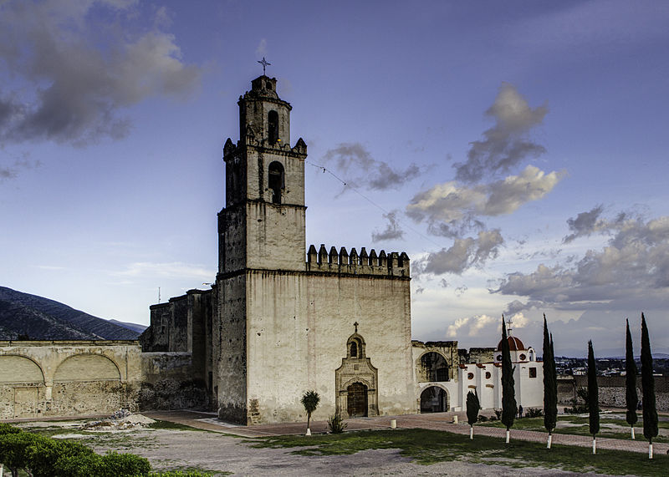
The Franciscans arrived in Tecamachalco, in the eastern Mexico state of Puebla, in 1541

Slide 8
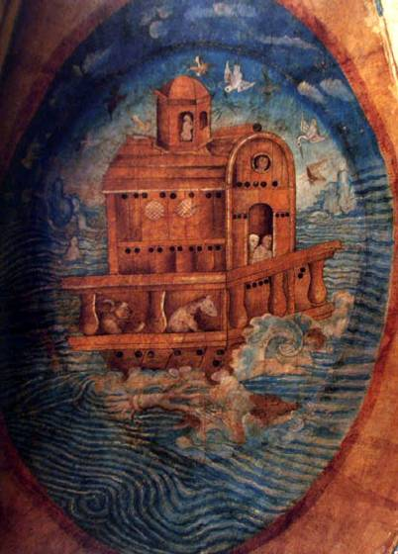
Juan Gersón, Noah’s Ark, pigment on traditional brown amate (bark) paper, 1562, one of 28 images mounted to the walls and ceiling of the church of Tecamachalco (near Puebla) Mexico. How is this a syncretic work?

Slide 9
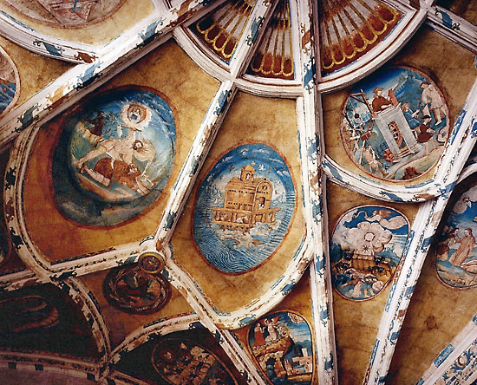
Vaulting with paintings by Juan Gersón, 1562; in the Franciscan church at Tecamachalco, Puebla, Mexico.

Slide 10
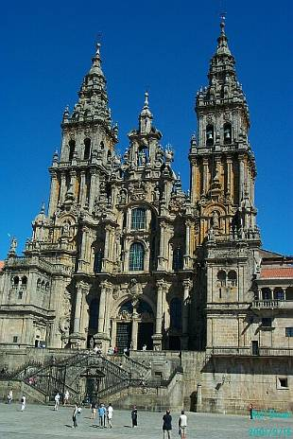
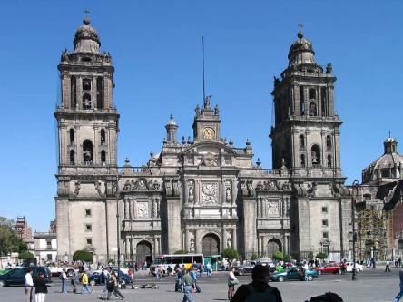
Spanish Baroque, western façade of Cathedral at Santiago de Compostela, Spain façade begun in 1715 and completed mid-19th century
(right) Cathedral of Mexico City, 1572-1813

Slide 11
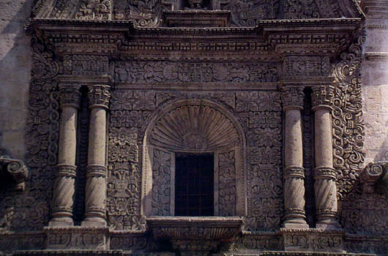
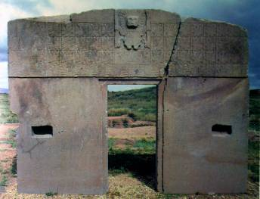
“Mestizo” façade of the church of Santiago, Arequipa, Peru, 1698; detail right compare (below left) Gate of the Sun, Tiahuanaco, Bolivia, 500-700 AD

Slide 12
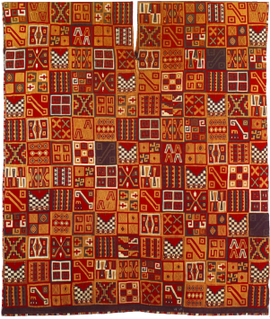
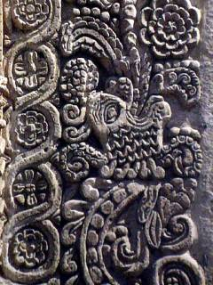
“Mestizo” façade of the church of Santiago, Arequipa, Peru, 1698; detail right compare, below left, Inca period woven tunic, c. 1476-1534

Slide 13
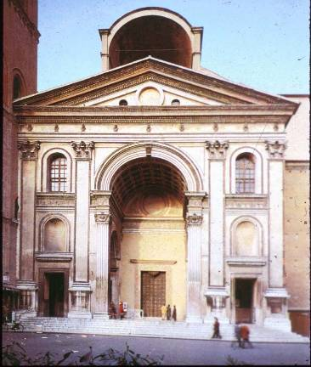
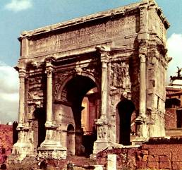
Compare (right) the church of Santiago, Arequipa, Peru, 1698, with (left) Leon Battista Alberti, Sant’ Andrea, Mantua, Italy, designed 1470 CE, Italian Renaissance derived from antique Roman triumphal arch (below center)
Forum of Rome, Arch of
Septimius Severus, 203 CE,

Slide 14
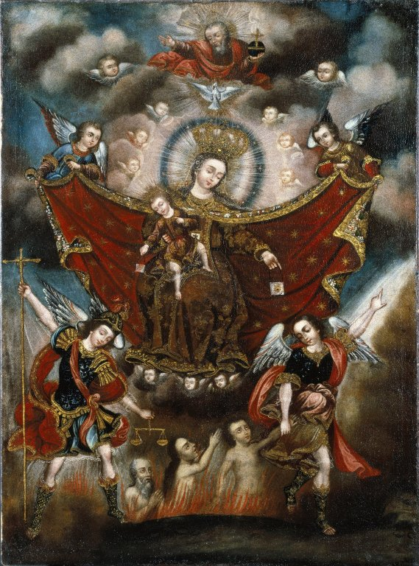
Virgin of Carmel Saving Souls in Purgatory, Circle of Diego Quispe Tito, Cuzco School, 17th century, collection of the Brooklyn Museum, New York.
Beginning in the 16th century decades after the conquest of the Inca empire, Cuzco (Inca capital) was considered the first artistic center that systematically taught European artistic techniques in the Americas

Slide 15
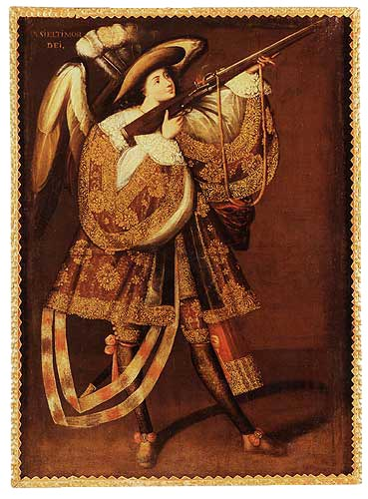
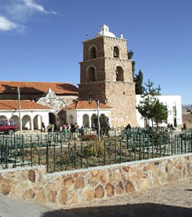
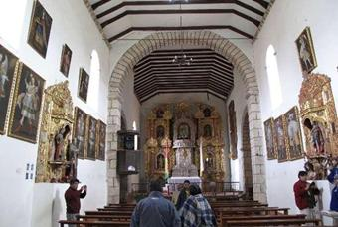
(left) Angel with a Harquebus by the Master of Calamarca, one of a series of 35 anonymous paintings for a Catholic mission (Santiago Parrish) in Calamarca, Bolivia, c.1684. Oil on canvas, 63 X 46”
The angels are androgynous

Slide 16
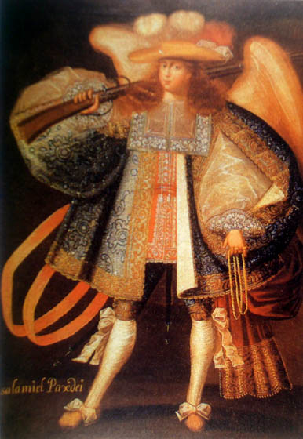
Archangel with Gun, Circle of the Master of Calamarca, late 17th century, oil on cotton, 18 ½ in H, Cuzco School (Peru, Bolivia and Equador). New Orleans Museum of Art
Do such images “renew,” “translate” or “appropriate” Catholic iconography?

Slide 17
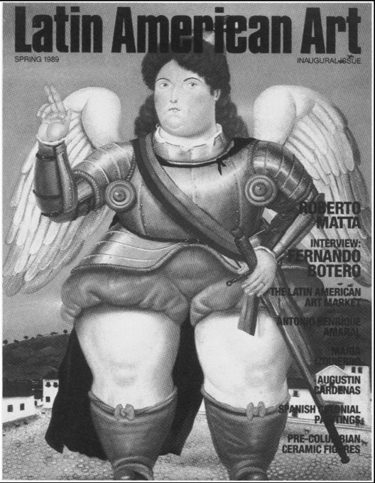

Slide 18
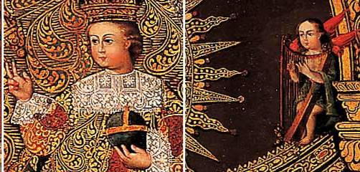
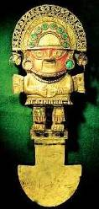
(left), Luis Niño (active 1716-1758), Our Lady of the Victory of Málaga, 59 x 43 in, 1730’s, Potosi, Peru. oil on canvas with gold stamping, Denver Museum. The new moon and vertical stripes on the skirt refer to the Inca tumi ceremonial knife and a pin worn by an Inca princess, pearls and flowers at feet may allude to Andean ritual offerings, Red feathered wings on angelic musicians is also Inca; red feathers were worn by Inca nobility.
details
Inca tumi

Slide 19
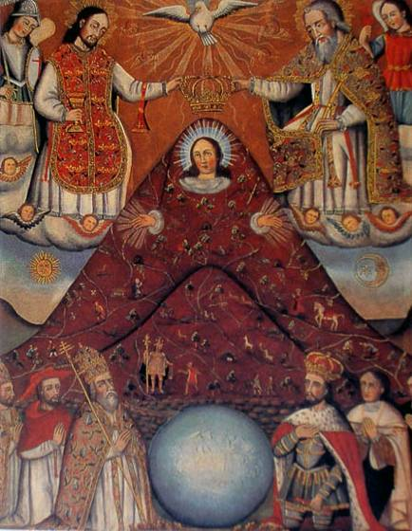
The Virgin Mary of the Cerro Rico of Potosi, 18th century, 53 x 41in, Casa Nacional de Moneda, Potosi, What are the Andean references? Cero Rico is the mountain that yielded enormous wealth for the Spanish. By 1600 Potosí was the largest metropolis in the Americas and a mercantile power of international renown.

Slide 20
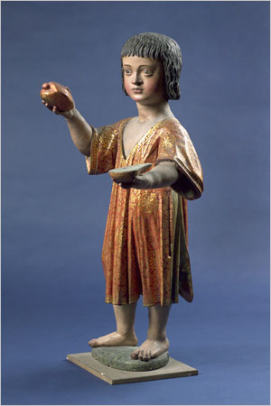
Does the ancient Andean practice of human sacrifice have some bearing on this early-17th-century Peruvian polychrome wood sculpture of the child Jesus as a dark-haired child wearing a red tunic and gravely presenting a human heart in his right hand while holding half a heart in his left?
Church of San Pedro, Lima, Peru

Slide 21
Felipe Guaman Poma de Ayala, The First Ambassador, The First New Chronicle and Good Government,1615

Slide 22
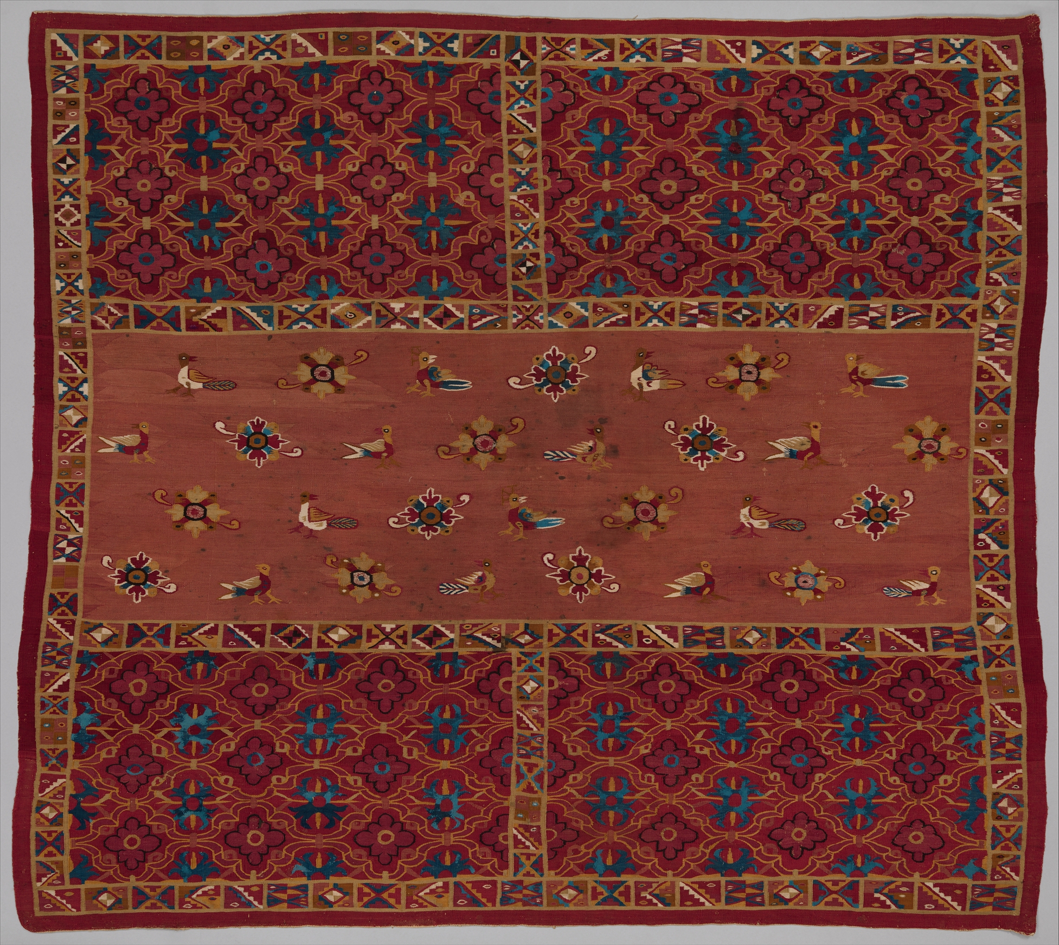
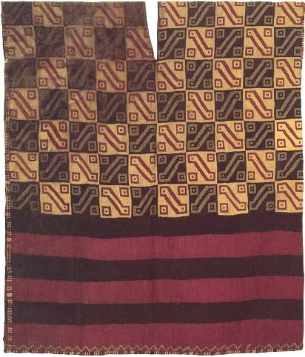
(right) Pre-Columbian Inca Tunic, alpaca, c.1400-1532 AD.
(left) 16th to early 17th century Andean woman’s tunic, cotton and camelid
Blend of European organic motifs with Andean geometrics. Communicated indigenous history and social rank. Colonial Andean tunics were potentially subversive.

Slide 23
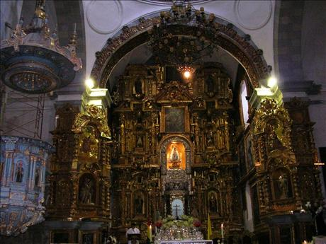
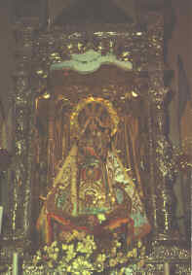
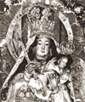
Francisco Tito Yupanqui (Andean), Our Lady of Copacabana (the “Dark Virgin”), 1583, Bolivia, plaster and fiber from the maguey plant, gold leaf, the garments reproduce the colors and dress of an Inca princess. The original shape is permanently hidden by rich robes and cloaks, and the carved hair has been covered by a wig. The image of the Virgin measures over four feet with the features of the inhabitants of the region. Powerful Catholic cults were generated by native Andeans.

Slide 24
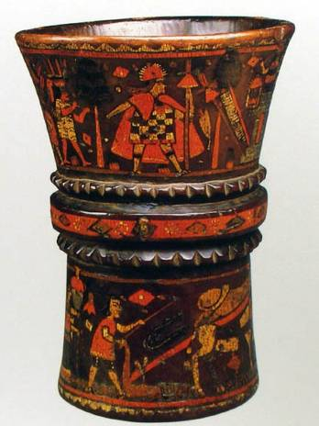
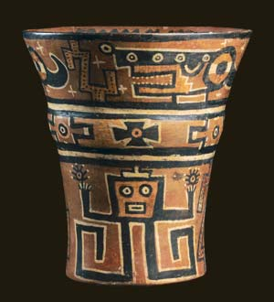
Colonial Andean Kero, late 17th-18th century, wood and pigment inlay, 8 in.
(right) Pre-conquest Kero, A.D. 1000-1200, Moquegua, Peru.

Slide 25
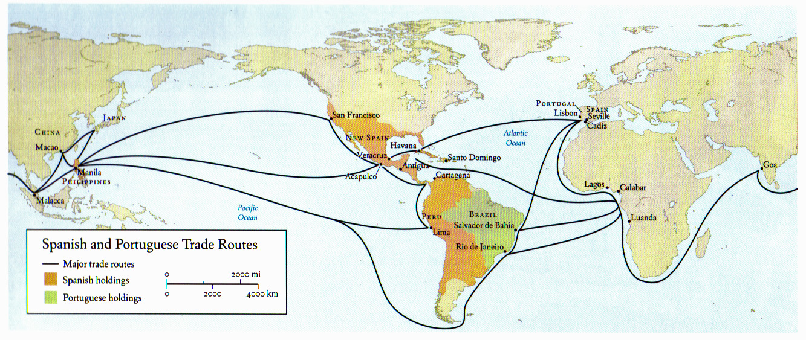

Slide 26
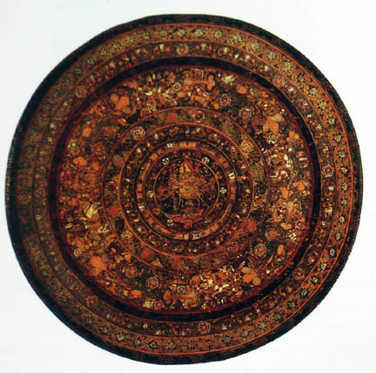
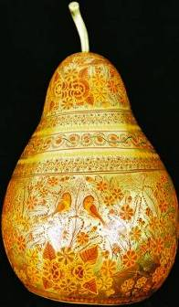
Batea (flat wooden tray), 17th century, inlaid lacquer, wood, 49 inches
Michoacán and Guerrero, Asian influence
Mexican lacquered
gourd

Slide 27
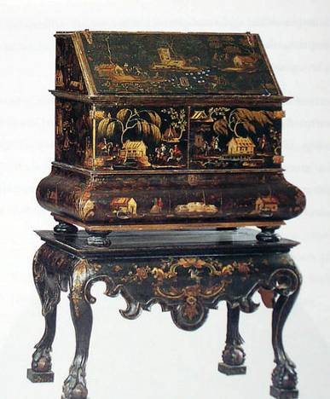
Manuel de la Cerda, Japanned writing desk, c. 1760, lacquered and painted wood 61 “ high, Japanese lacquer, The Hispanic Society of America, NYC

Slide 28
The Virgin of Guadalupe:
Symbol of Conquest or Liberation?
Article by Jeanette Peterson, Ph.D. in Latin American art history from UCLA, Associate Professor of Art History, UC Santa Barbara and author of The Paradise Garden Murals of Malinalco: Utopia and Imperial Policy in Sixteenth-century Mexico

Slide 29
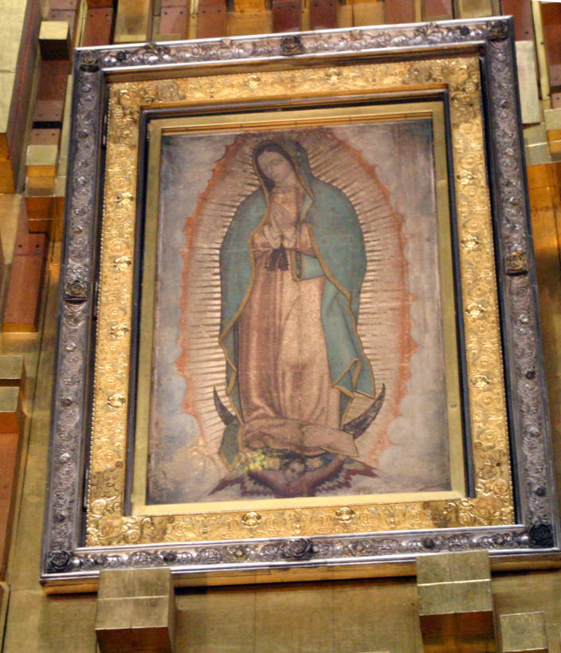
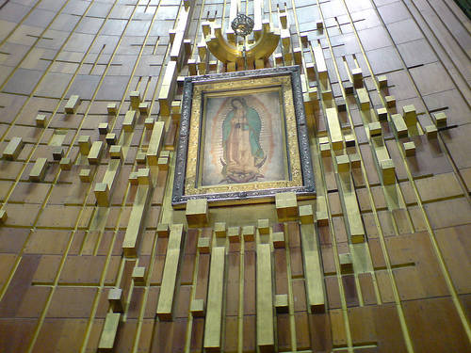
Virgin of Guadalupe, 16th century, oil and tempera (?) on maguey cactus cloth and cotton, 69 x 41 inches, Basilica of Guadalupe, Mexico City

Slide 30
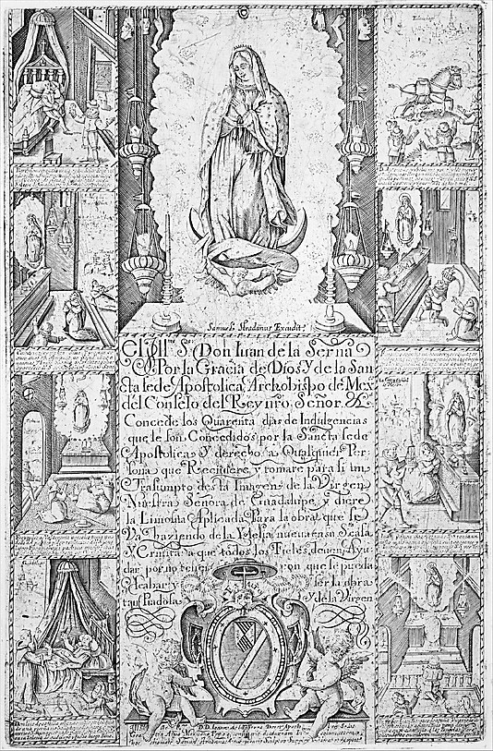
Samuel Stradanus, Indulgence for Alms toward the Erection of a Church Dedicated to the Virgin of Guadalupe, ca. 1615-20, copper engraving, c.13 x 8 inches, Metropolitan MA, NYC
Ex votos represent miracles performed by the Virgin on behalf of the creole white ruling class

Slide 31
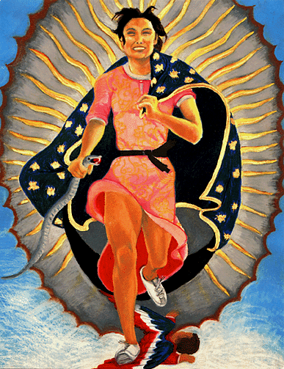
Yolanda Lopez, Self-Portrait as a Jogger with Symbols of Guadalupe, 1978, oil and pastel on paper, 26 x 22 inches

